Slide 1

Analysis of Weather Data
A study of New York state between the years of 2015 to 2020 focused on temperature and precipitation
ALEKSANDAR KAMENEV
LAKSHMI BHAVANI CHEEKALA
RAVI KONJETI

Slide 2
Introduction
Weather analysis, in particular temperature and precipitation, have been the focus of many fruitful studies. Global warming is a well discussed issue. A myriad of opinions have been expressed on the topic. While the majority of research provides strong evidence chronicling the effect and its theorized causes, consensus on the matter is not yet unanimous.
In our exploratory research we aim to find patterns in temperature rises and consequentially rises in precipitation.
While the time frame of this study is rather narrow compared to the large body of research in the field, it is our belief that it’s sufficient to produce meaningful observations.

Slide 3
Inspirational Material
Similar studies done by A. Agrawal and A. Ghosh in in the area of weather and temperature analysis and visual mapping of climate sparked this research team’s interest and motivated us to explore changes in precipitation and temperature in New York state.
Our areas of interest include variance of average, minimum and maximum temperature, and precipitation for the time period as recorded by five weather stations distributed across the state.
We compare data from the different stations for the whole time period as well as make comparisons for each year.

Slide 4
Problem Definition
To observe temperature and precipitation changes over a six-year period in NY state aiming to provide evidence supporting the validity of global warming.

Slide 5
Data Source
The data used for this study was sourced from the National Centers for Environmental Information.
A full data dictionary provided by the source can be found here. A short version relevant to our work is present in the project’s notebook.

Slide 6
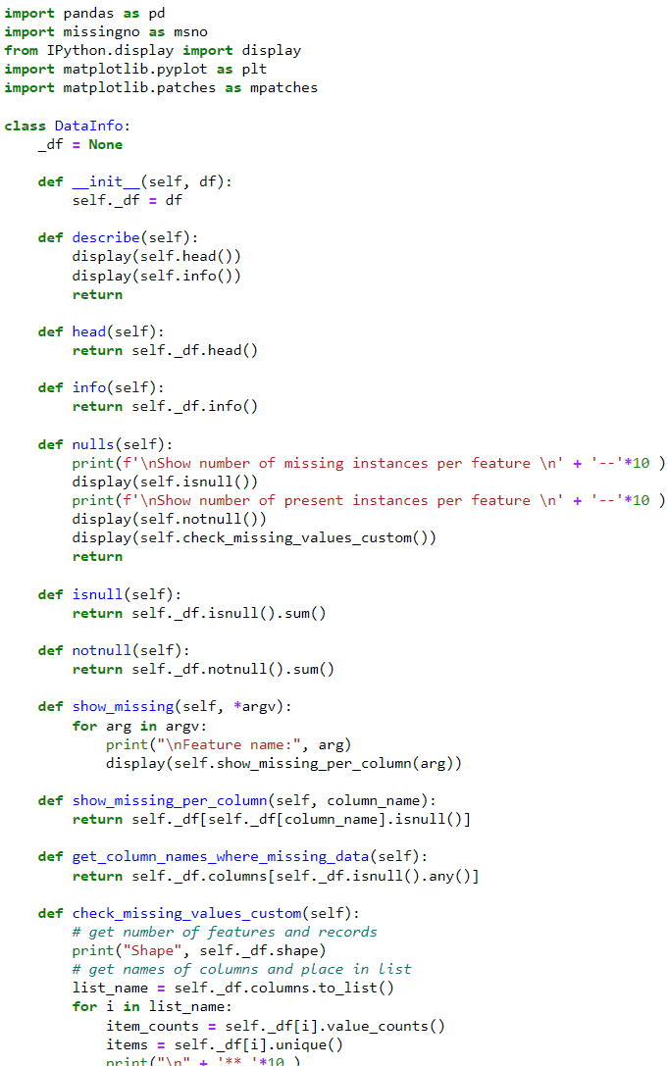
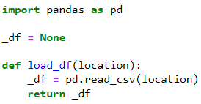

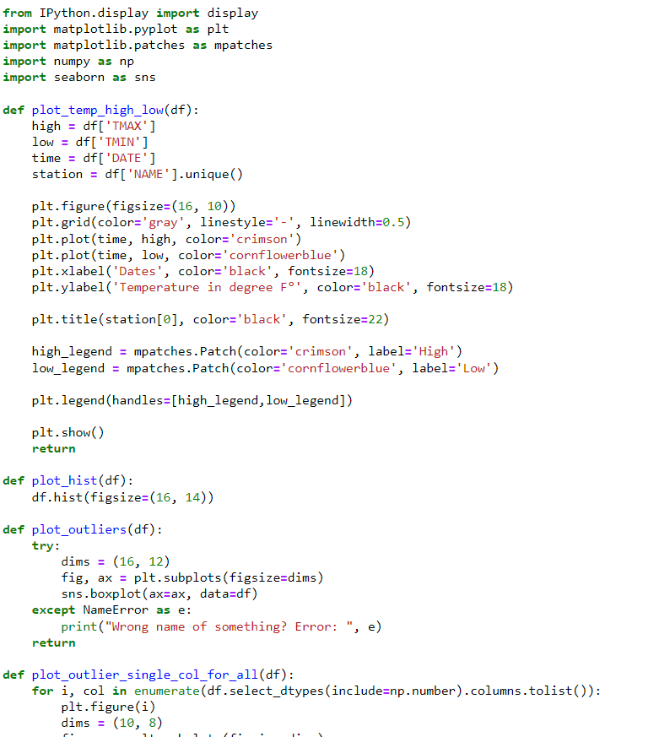
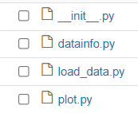
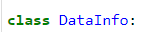
package
class

Slide 7
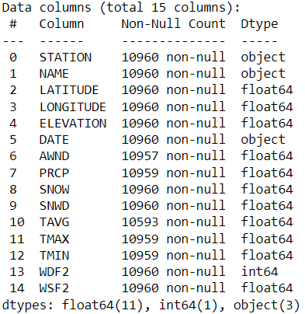
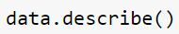
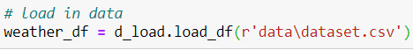
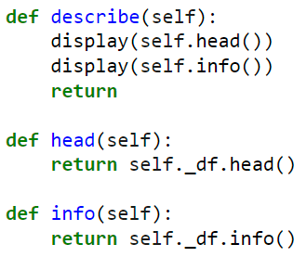
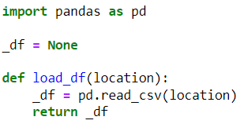
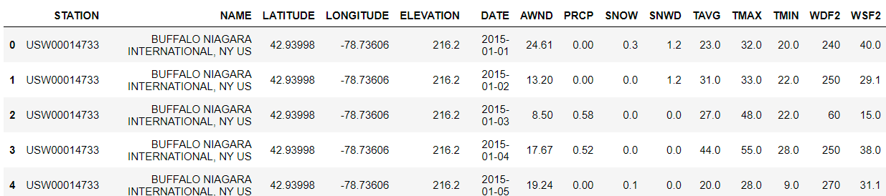
Dataset

Slide 8
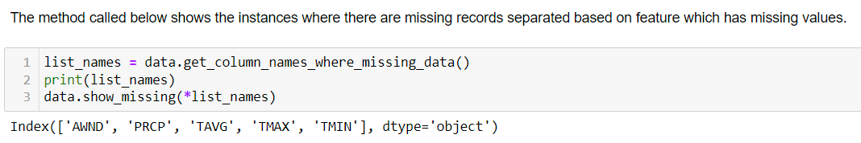
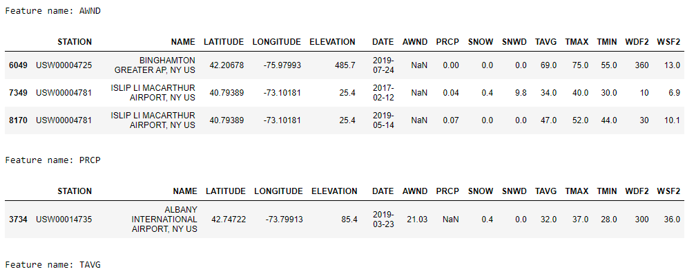
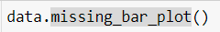
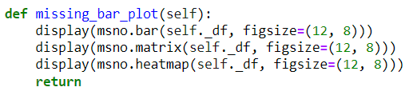
Missing Values
Please reference notebook for output
Output on next page

Slide 9
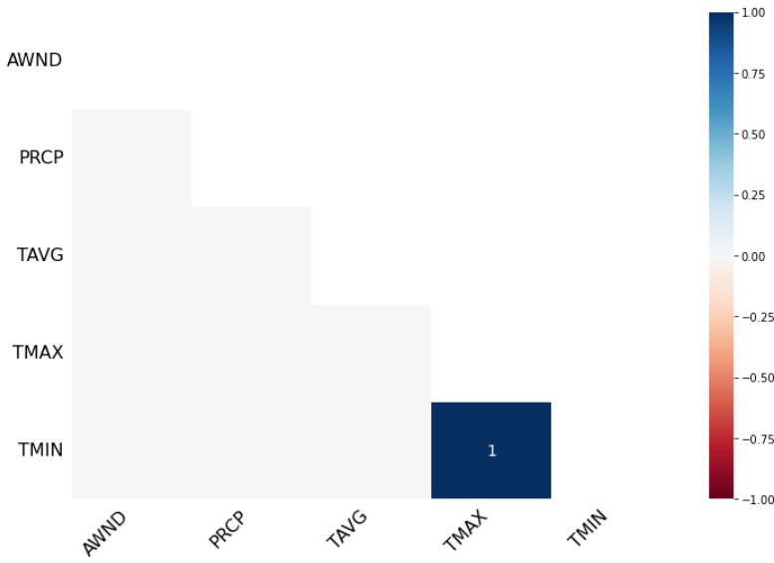
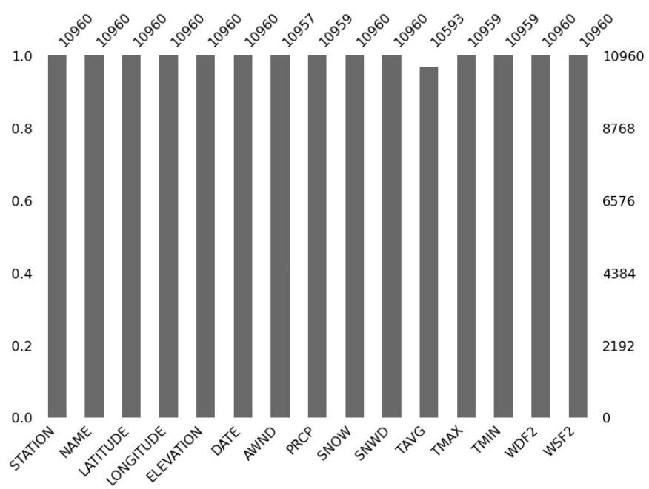
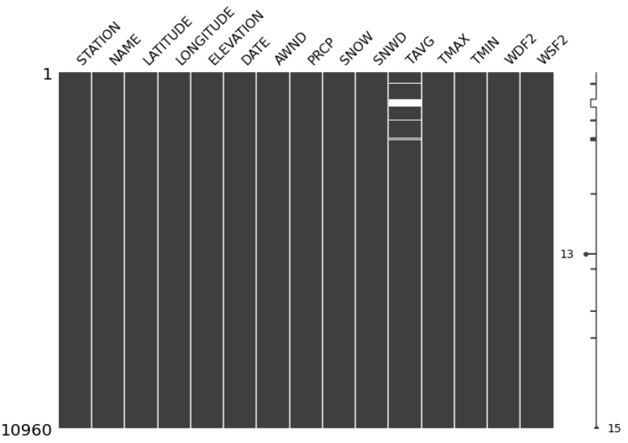
Visualize Missing Values

Slide 10
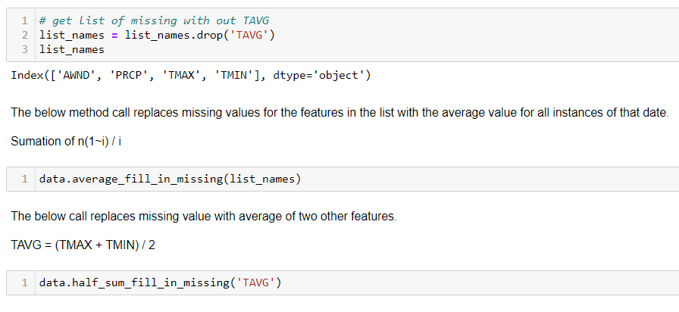
Handle Missing

Slide 11
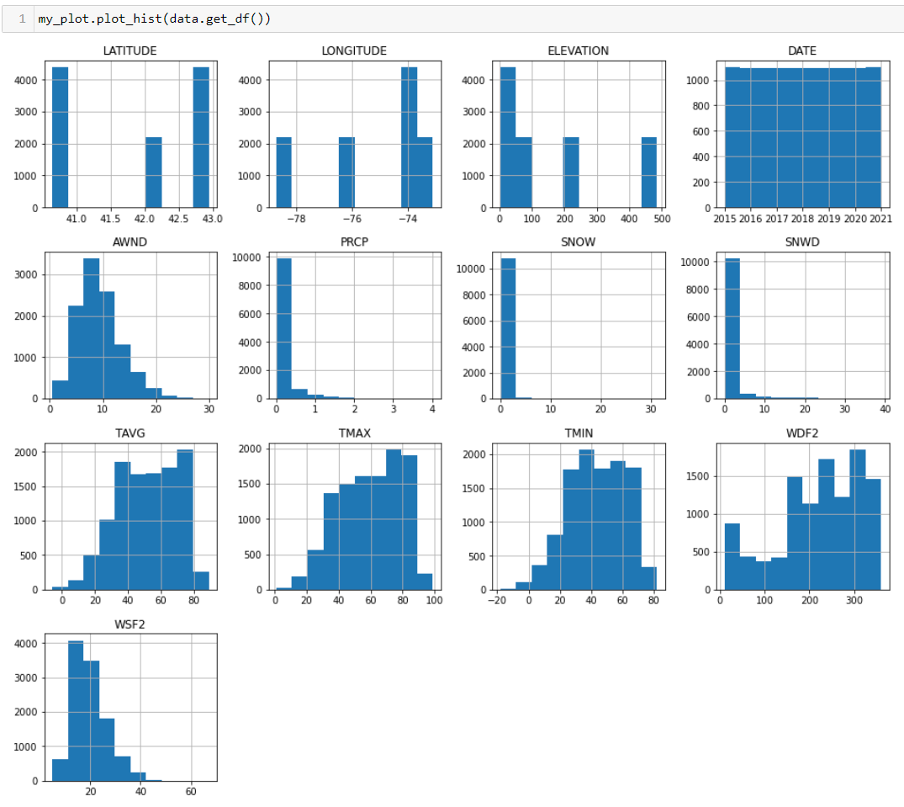
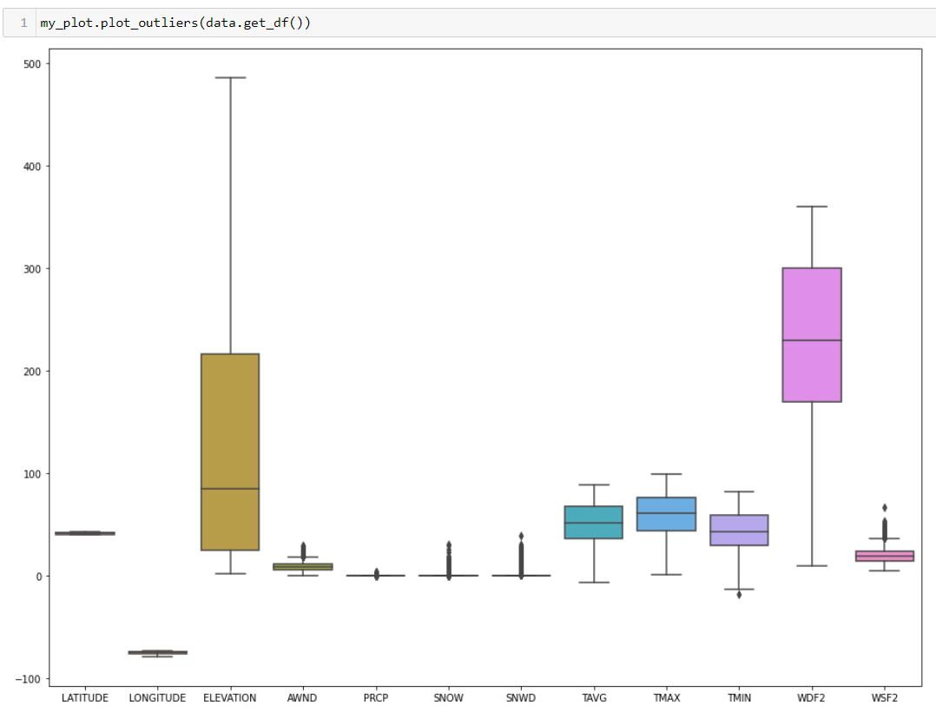
Distribution & Outliers

Slide 12
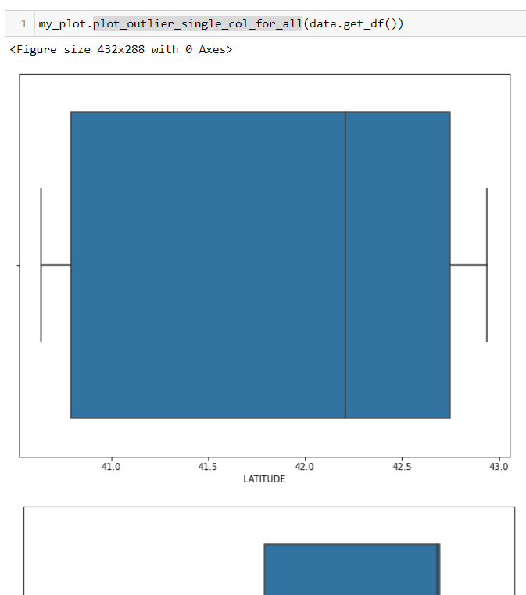
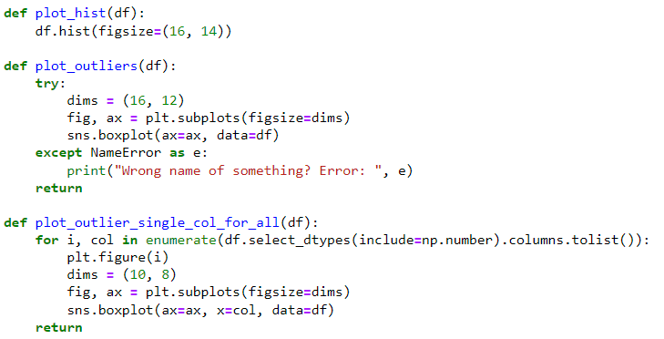
Distribution & Outliers
Plots for the other features are available in the project’s notebook.

Slide 13
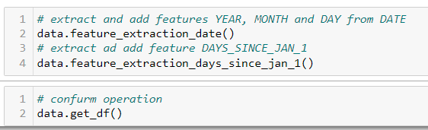
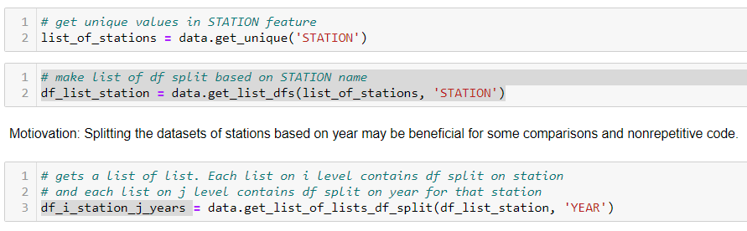
SPLIT DATASET

Slide 14
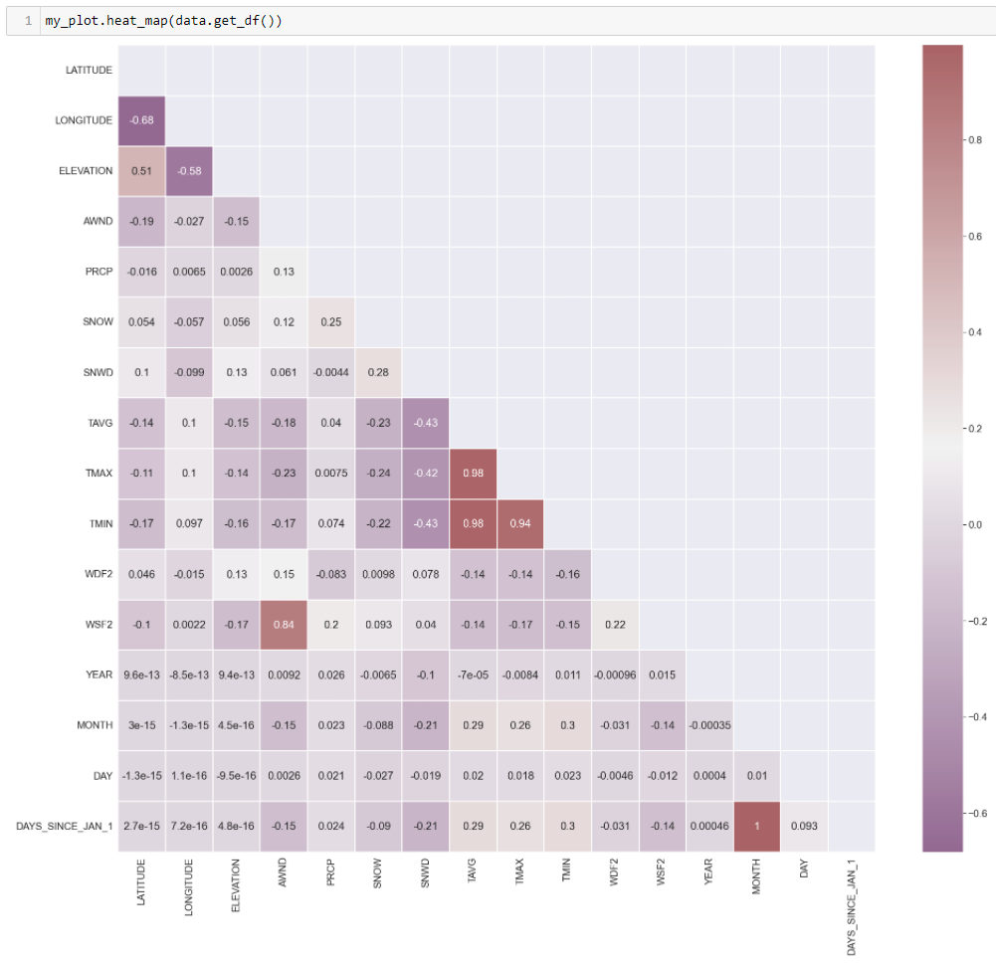
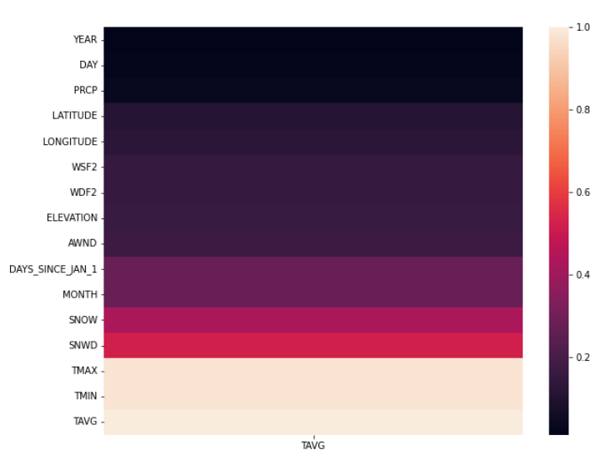
VISUAL ANALYSIS
Plots for the other features are available in the project’s notebook.

Slide 15
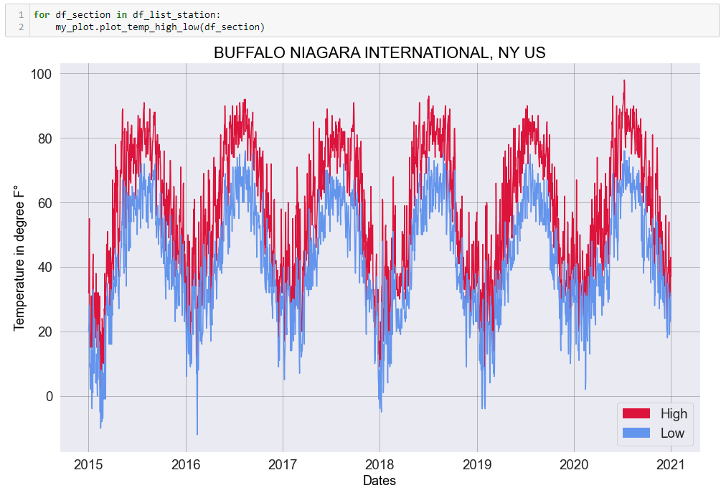
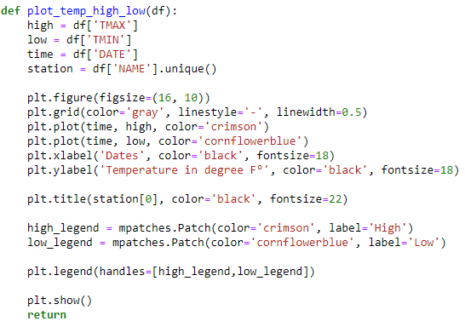
Min & Max Temp.
Plots for the other stations available in the project’s notebook.

Slide 16
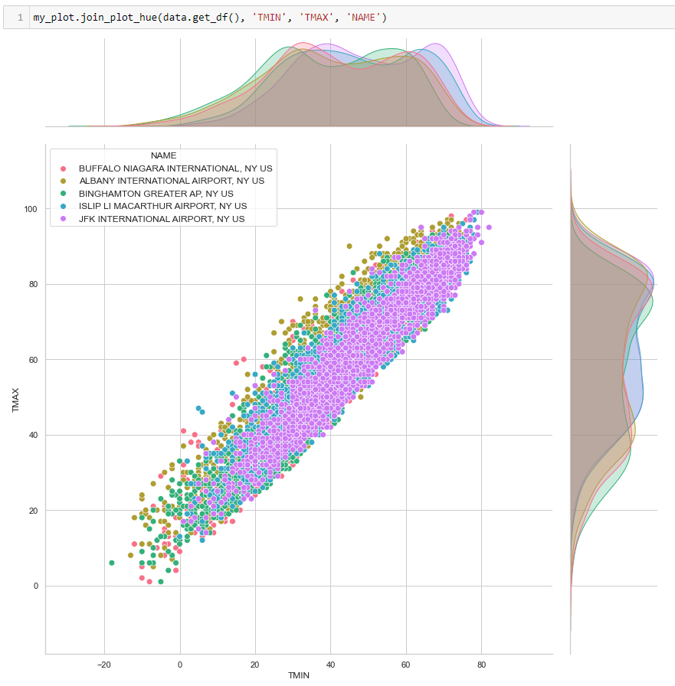
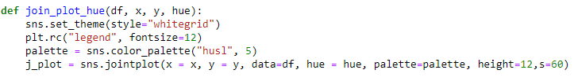
Min & Max Temp.

Slide 17
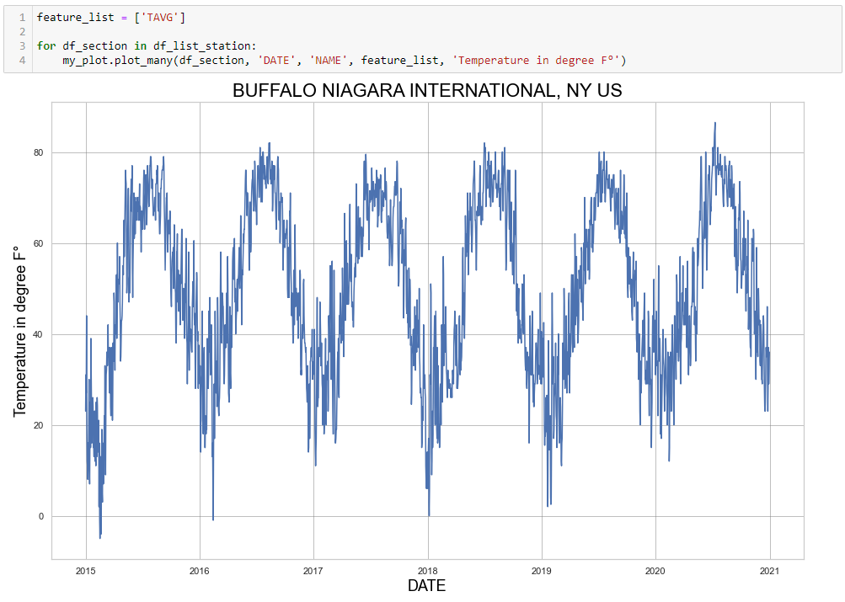
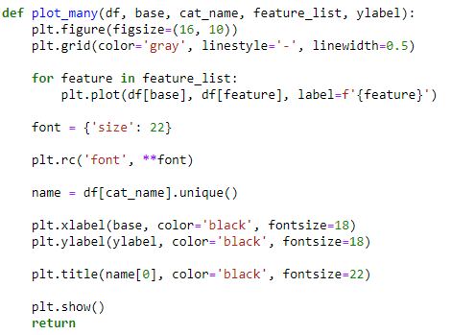
Min & Max Temp.
Plots for the other stations available in the project’s notebook.

Slide 18
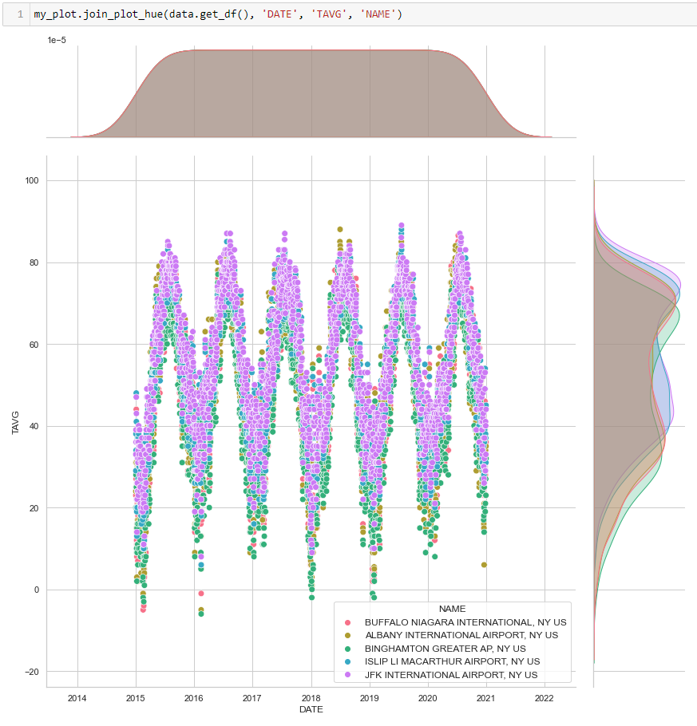
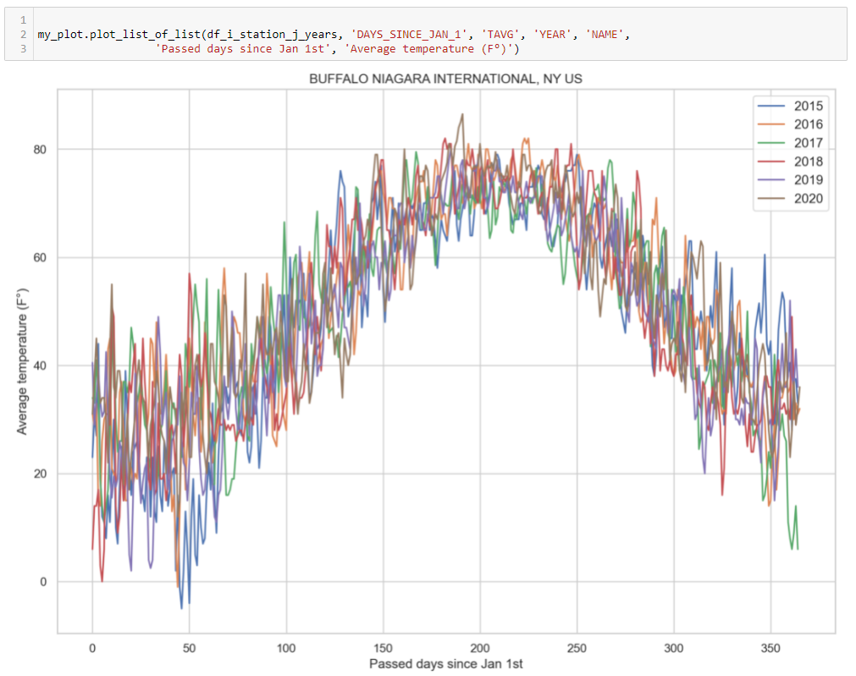
Min & Max Temp.

Slide 19
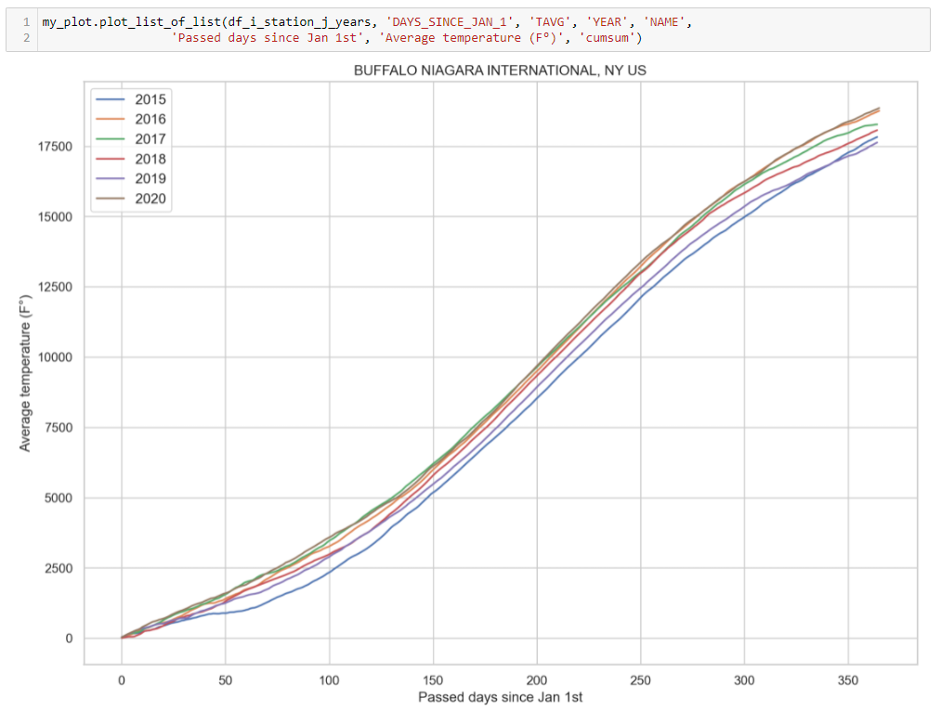
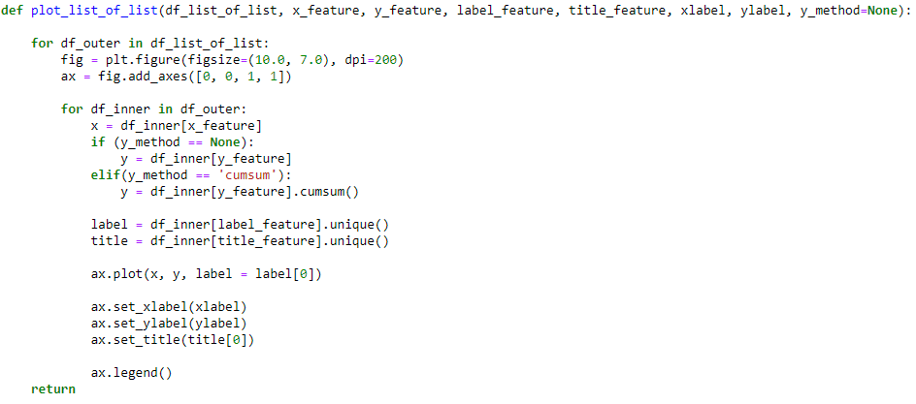
Min & Max Temp.
Plots for the other stations available in the project’s notebook.

Slide 20
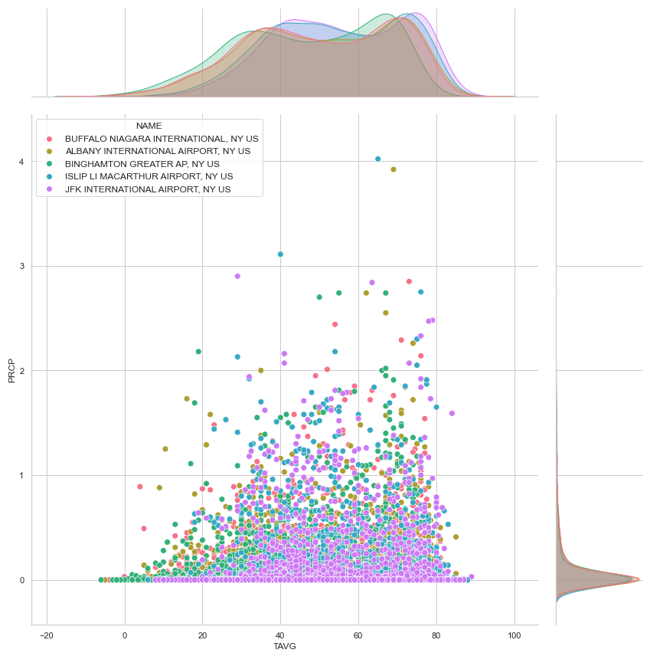
Precipitation & TAVG

Slide 21
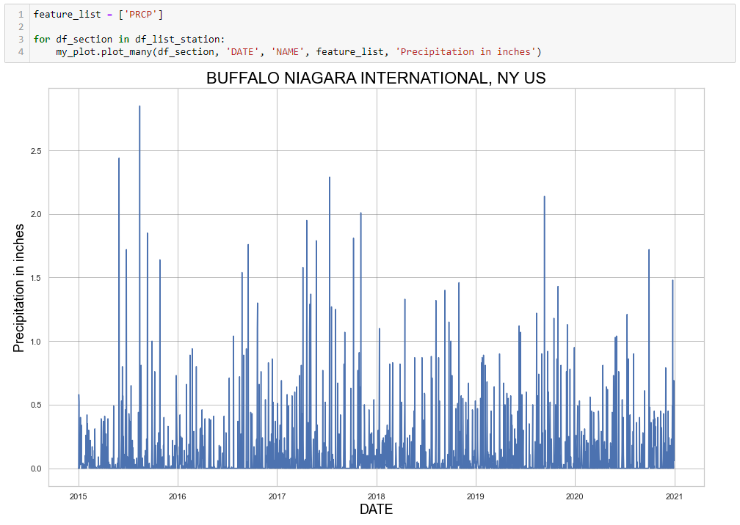
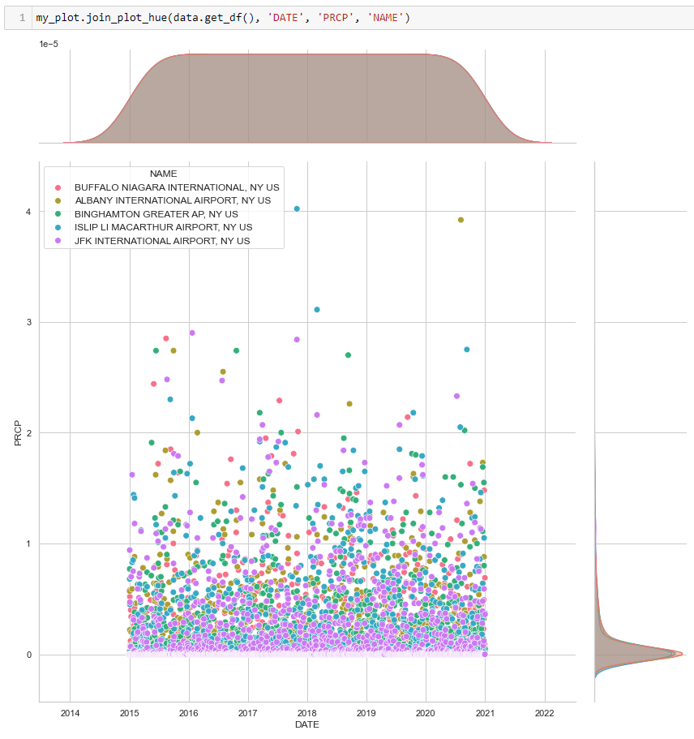
Precipitation
In meteorology, precipitation is any product of the condensation of atmospheric water vapor that falls under gravitational pull from clouds. The main forms of precipitation include drizzling, rain, sleet, snow, ice pellets, graupel and hail.

Slide 22
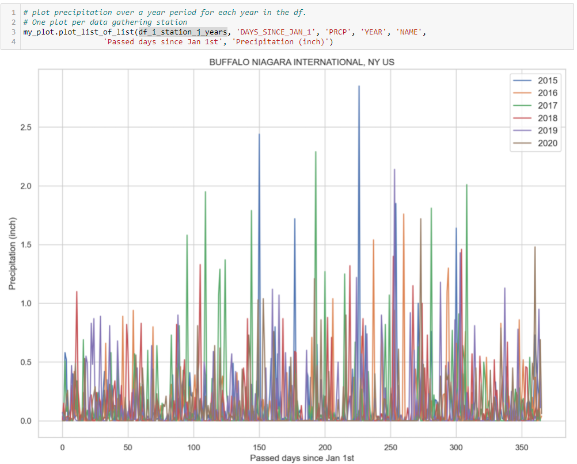
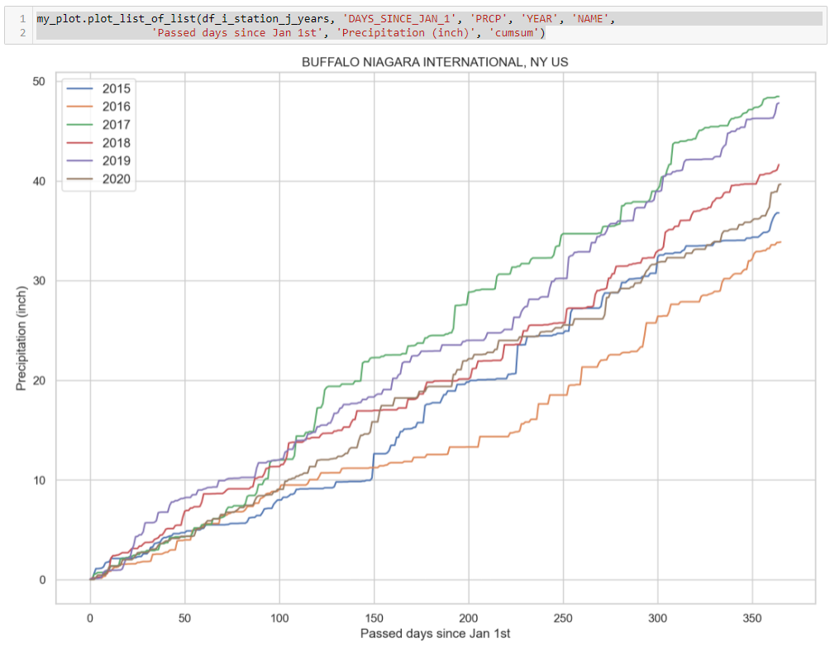
Precipitation
Plots for the other stations available in the project’s notebook.

Slide 23
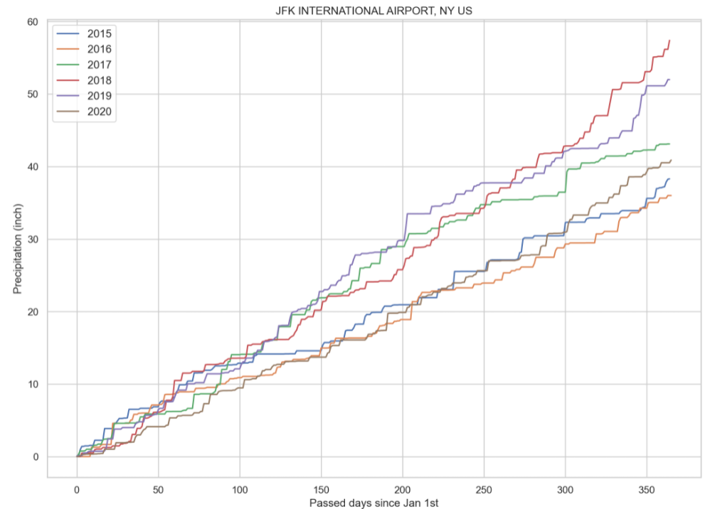
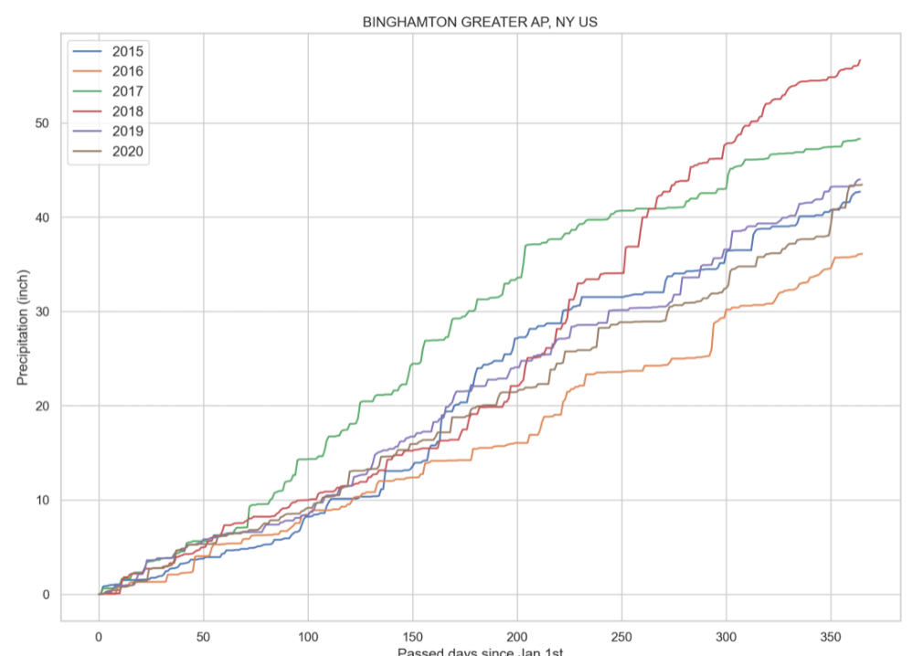
Precipitation

Slide 24
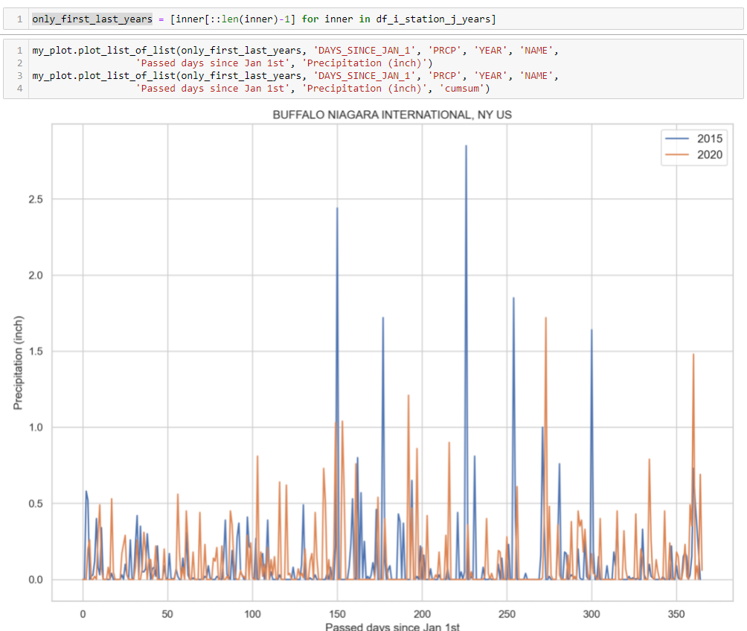
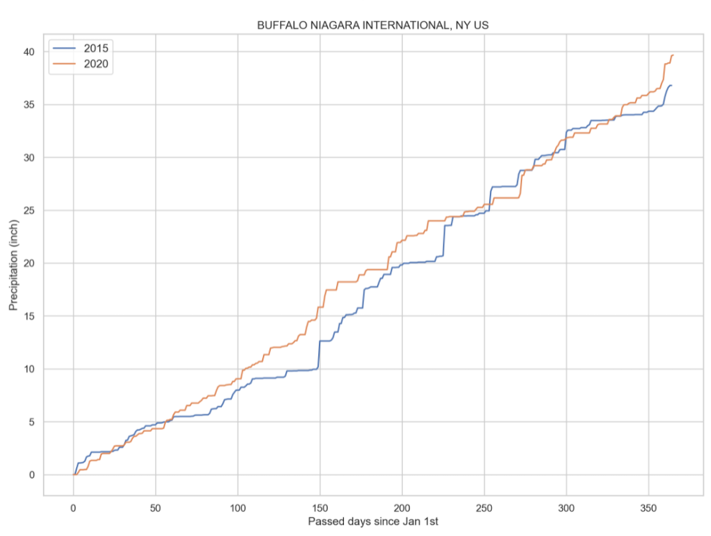
Precipitation

Slide 25
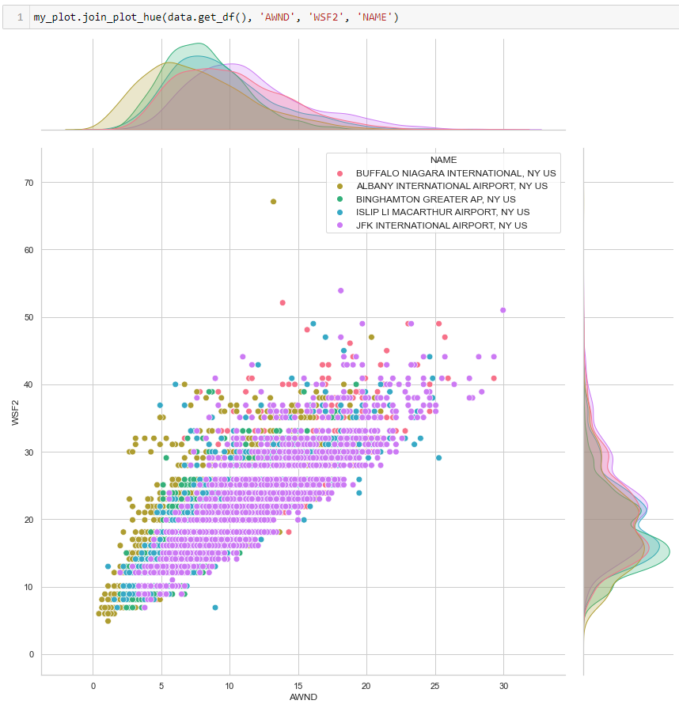
Wind speed

Slide 26
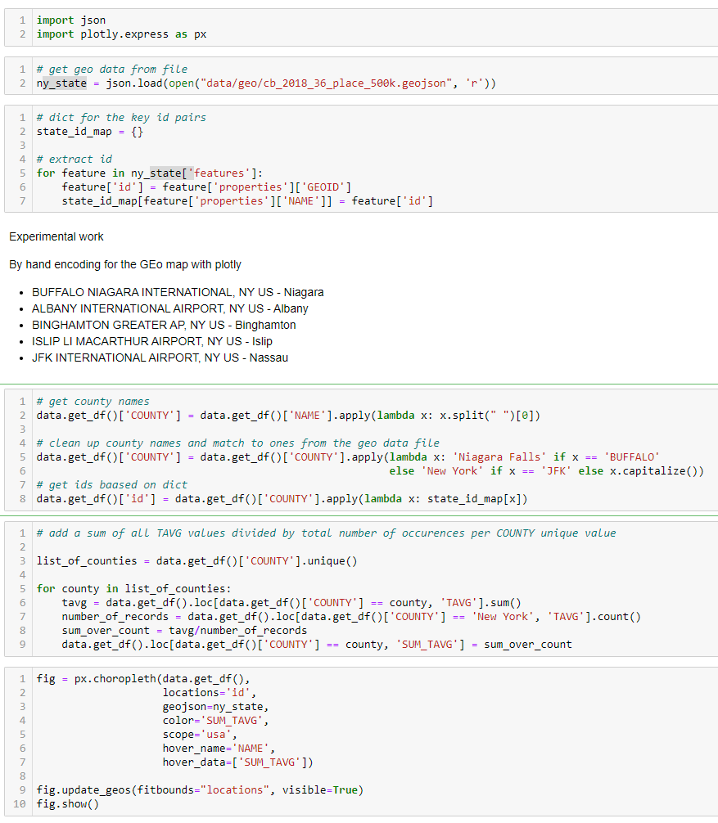
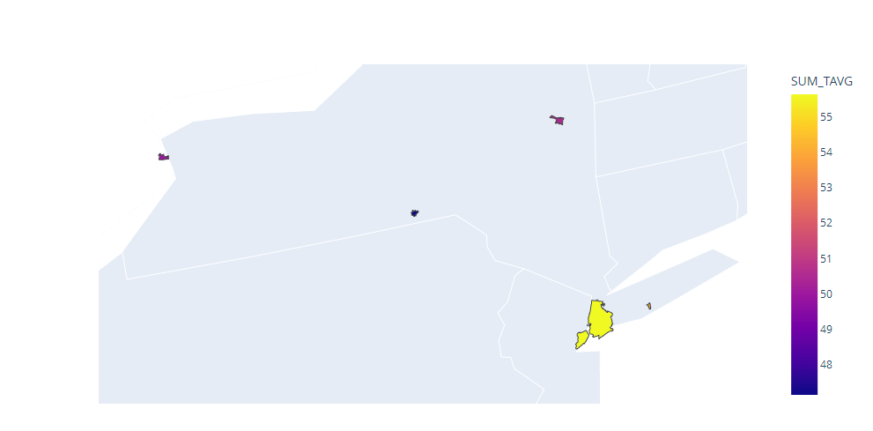
Geo Map

Slide 27
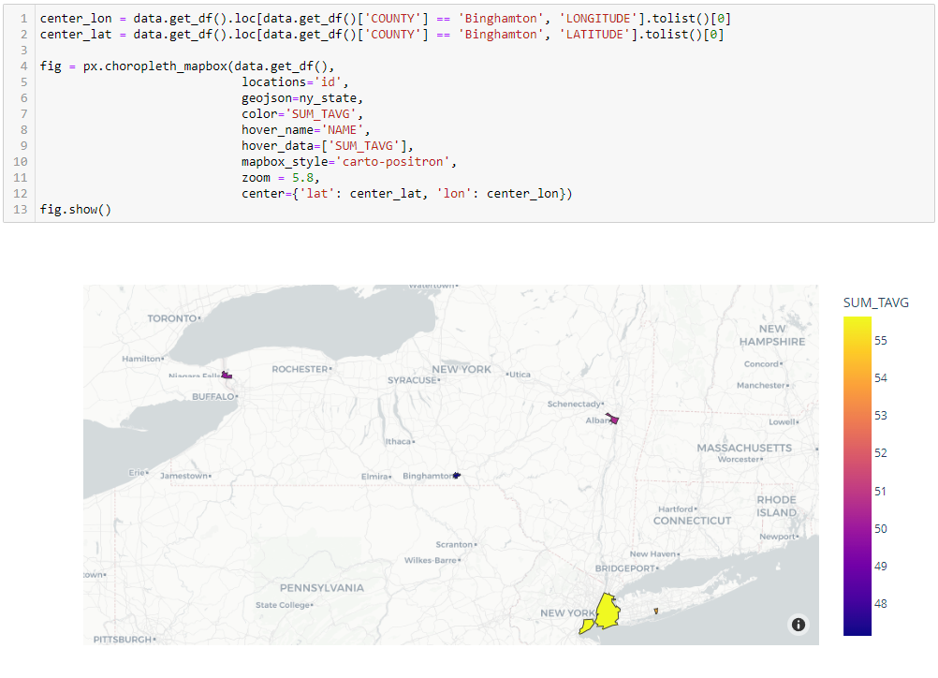
Geo Map

Slide 28
Ending Remarks
Through our observations we have extrapolated that with the progression of time over a six-year period in NY state, there is an increase in both precipitation and temperature on a minimum and maximum scale, as well as a rise in the accumulative average. This is in line with our original hypothesis stated at the beginning of this study.
We can also conclude that on average, certain parts of the state tend to consistently be warmer even though geographically close. The warmest on average of these stations has been JFK.
We consistently see that Albany, specifically, experiences higher maximums and lower minimums than the other stations.

Slide 29
Future Work
Future studies may include further exploration of not naively correlational features but still show a sufficient correlation.
Further exploration of the relation between precipitation and temperature may be fruitful, including the effect that elevation has on these readings and the strength of the correlation.
Both the topic and the dataset appear to be well suited for time series analysis with the aim of obtaining highly probable values of time periods yet to occur.
It would be beneficial to continue gathering data, including a weather station from each county of New York state, to gain a more holistic view of weather patterns statewide.
This study could also be expanded to include similar case studies of different areas of the world over the same six-year period, to compare rate of temperature and precipitation increase on a world scale.

Slide 30
References
A. Agrawal, D. Verma and S. Gupta, "Exploratory data analysis on temperature data of Indian states from 1800–2013 (Analysis of trends in temperature data for prediction modelling)," 2016 2nd International Conference on Next Generation Computing Technologies (NGCT), 2016, pp. 547-552, doi: 10.1109/NGCT.2016.7877475.
A. Ghosh and P. Joshi, "Hyperspectral imagery for disaggregation of land surface temperature with selected regression algorithms over different land use land cover scenes", ISPRS Journal of Photogrammetry and Remote Sensing, vol. 96, pp. 76-93, 2014.
A. S. Rao, B. V. Vardhan and H. Shaik, "Role of Exploratory Data Analysis in Data Science," 2021 6th International Conference on Communication and Electronics Systems (ICCES), 2021, pp. 1457-1461, doi: 10.1109/ICCES51350.2021.9488986.

